Slide 1
United States Cancer Statistics
1999 - 2010
CS 329E Data Visualization • Final Project • 2015
Alex Cortez • Adam Hernandez • Alex Pearce

Slide 2
The Data
This data was provided by the Enigma.io database. It is described as such:
United States Cancer Statistics (USCS) information is aggregated from thousands of local cancer registries and published by the National Program of Cancer Registries (NPCR), a division of the Centers for Disease Control and Prevention (CDC).

Slide 3
Ten Separate Tables
Age Adjusted Rates for Childhood Cancer (528 records, 10 fields)
Age Adjusted Rates for Childhood Cancer by ICCC site (1464 records, 9 fields)
Age Specific Rates of Childhood Cancer by ICC Site (3660 records, 9 fields)
Age Specific Rates of Childhood Cancer by Site (4080 records, 10 fields)
Brain Cancer by Site (2940 records, 14 fields)
Cancer by Age (206568 records, 12 fields)
Cancer by Area (653952 records, 15 fields)
Cancer by Site (31752 records, 14 fields)
Childhood Cancer by ICCC site (1464 records, 14 fields)
Childhood Cancer by Site (5016 records, 15 fields)

Slide 4
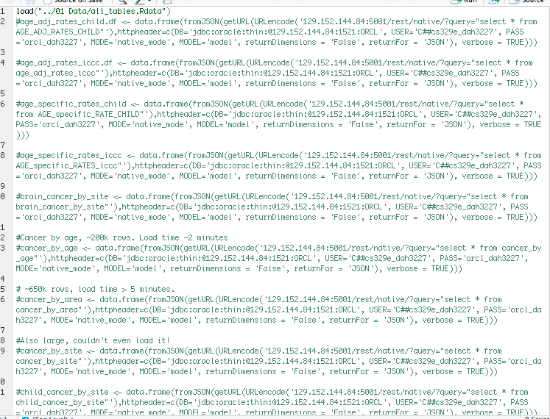
Retrieving the tables

Slide 5
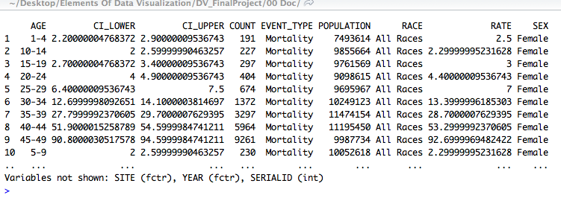
Sample of the Data

Slide 6
R Packages
ggplot2
gplots
grid
plyr
RCurl
reshape2
dplyr
tidyr
jsonlite
knitr

Slide 7
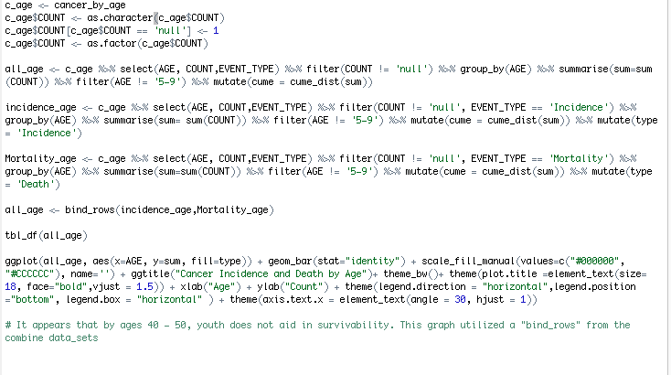

Slide 8
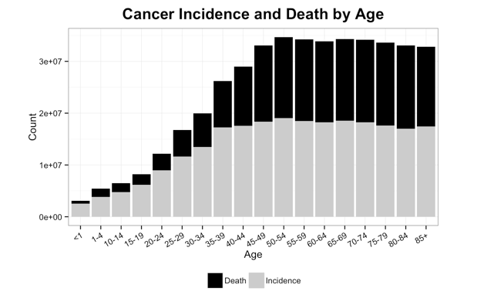

Slide 9
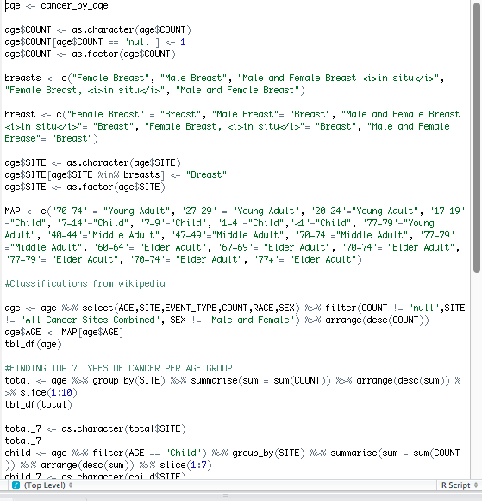
Joining Age and Site
… and cleaning up the data.

Slide 10
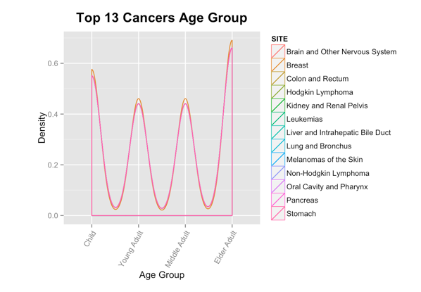
Not incredibly interesting...

Slide 11
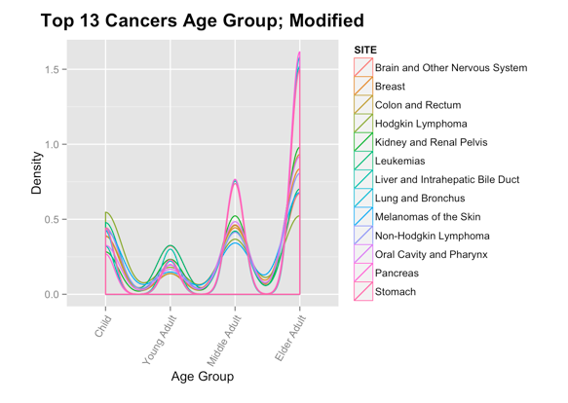
Better! But what does it mean?!

Slide 12
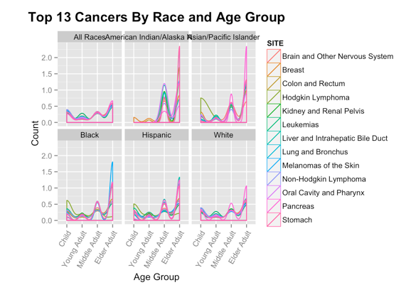
Population size matters…?!

Slide 13
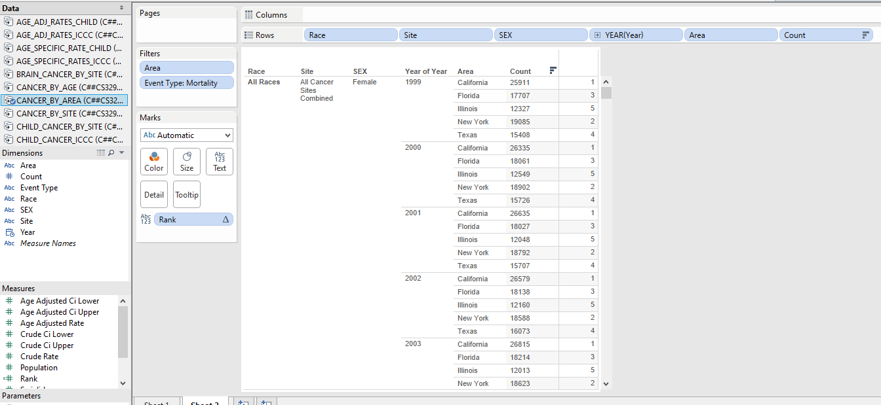
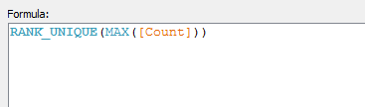
Rank Crosstab in Tableau

Slide 14
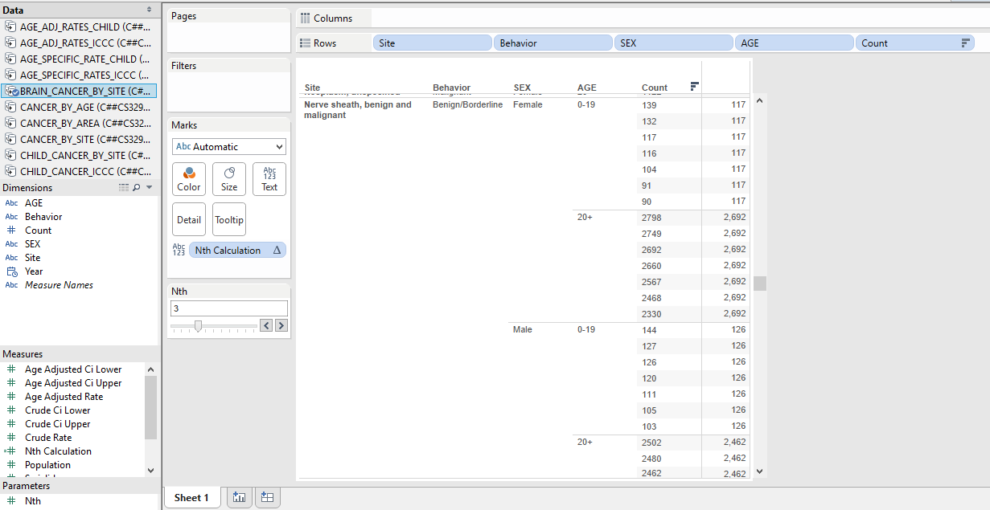
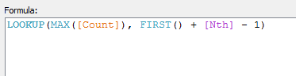
Nth Crosstab in Tableau

Slide 15
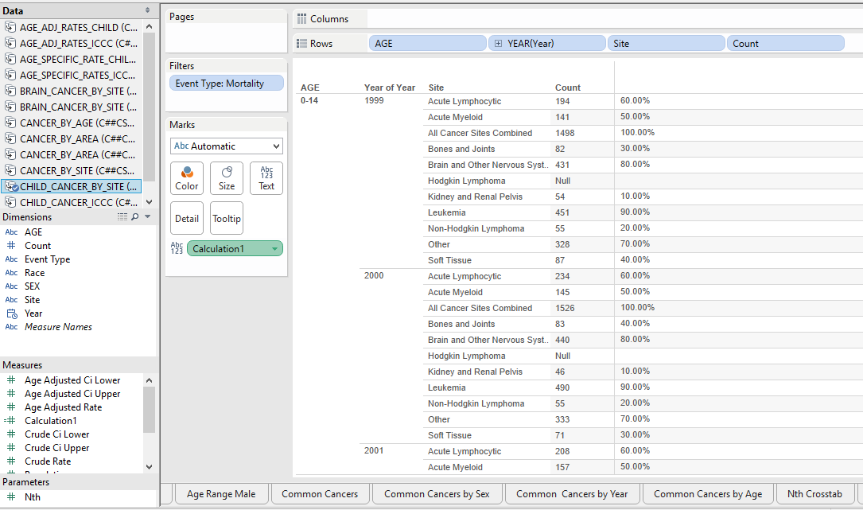
Cumulative Distribution Crosstab in Tableau

Slide 16
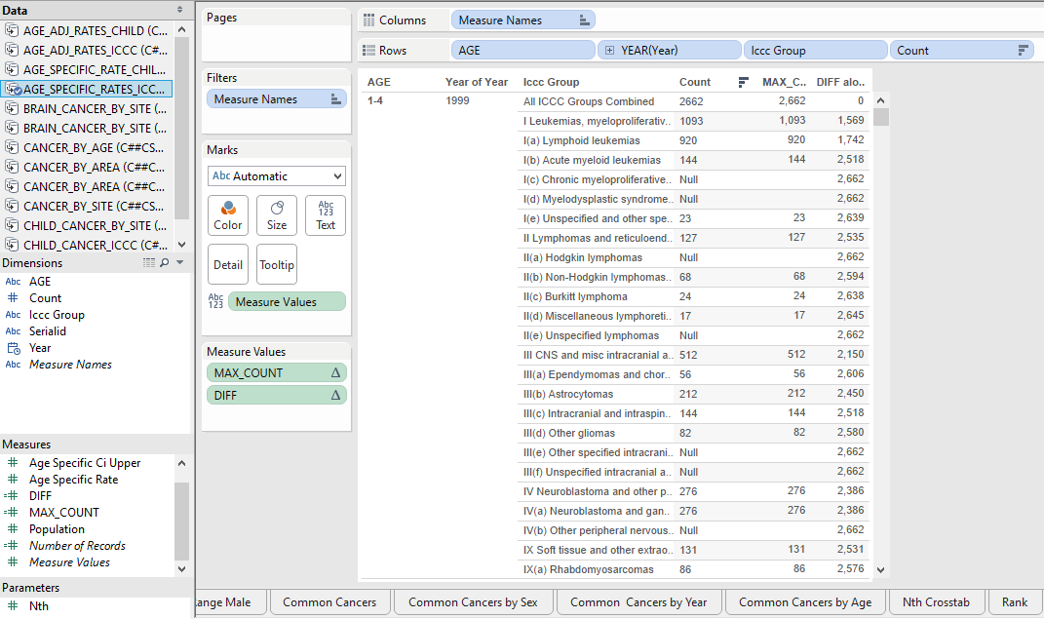
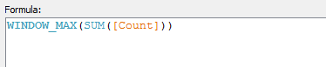
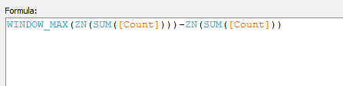
Maximum & Difference Crosstabs in Tableau

Slide 17
Some quick observations from the crosstabs alone...
Don’t move to California.
There is a huge difference in the number of cancer cases in people <19 years old and those >19. Typically, one to two orders of magnitude higher.
A child is more likely to have leukemia than bone or joint related cancers (or any cancer for that matter).

Slide 18
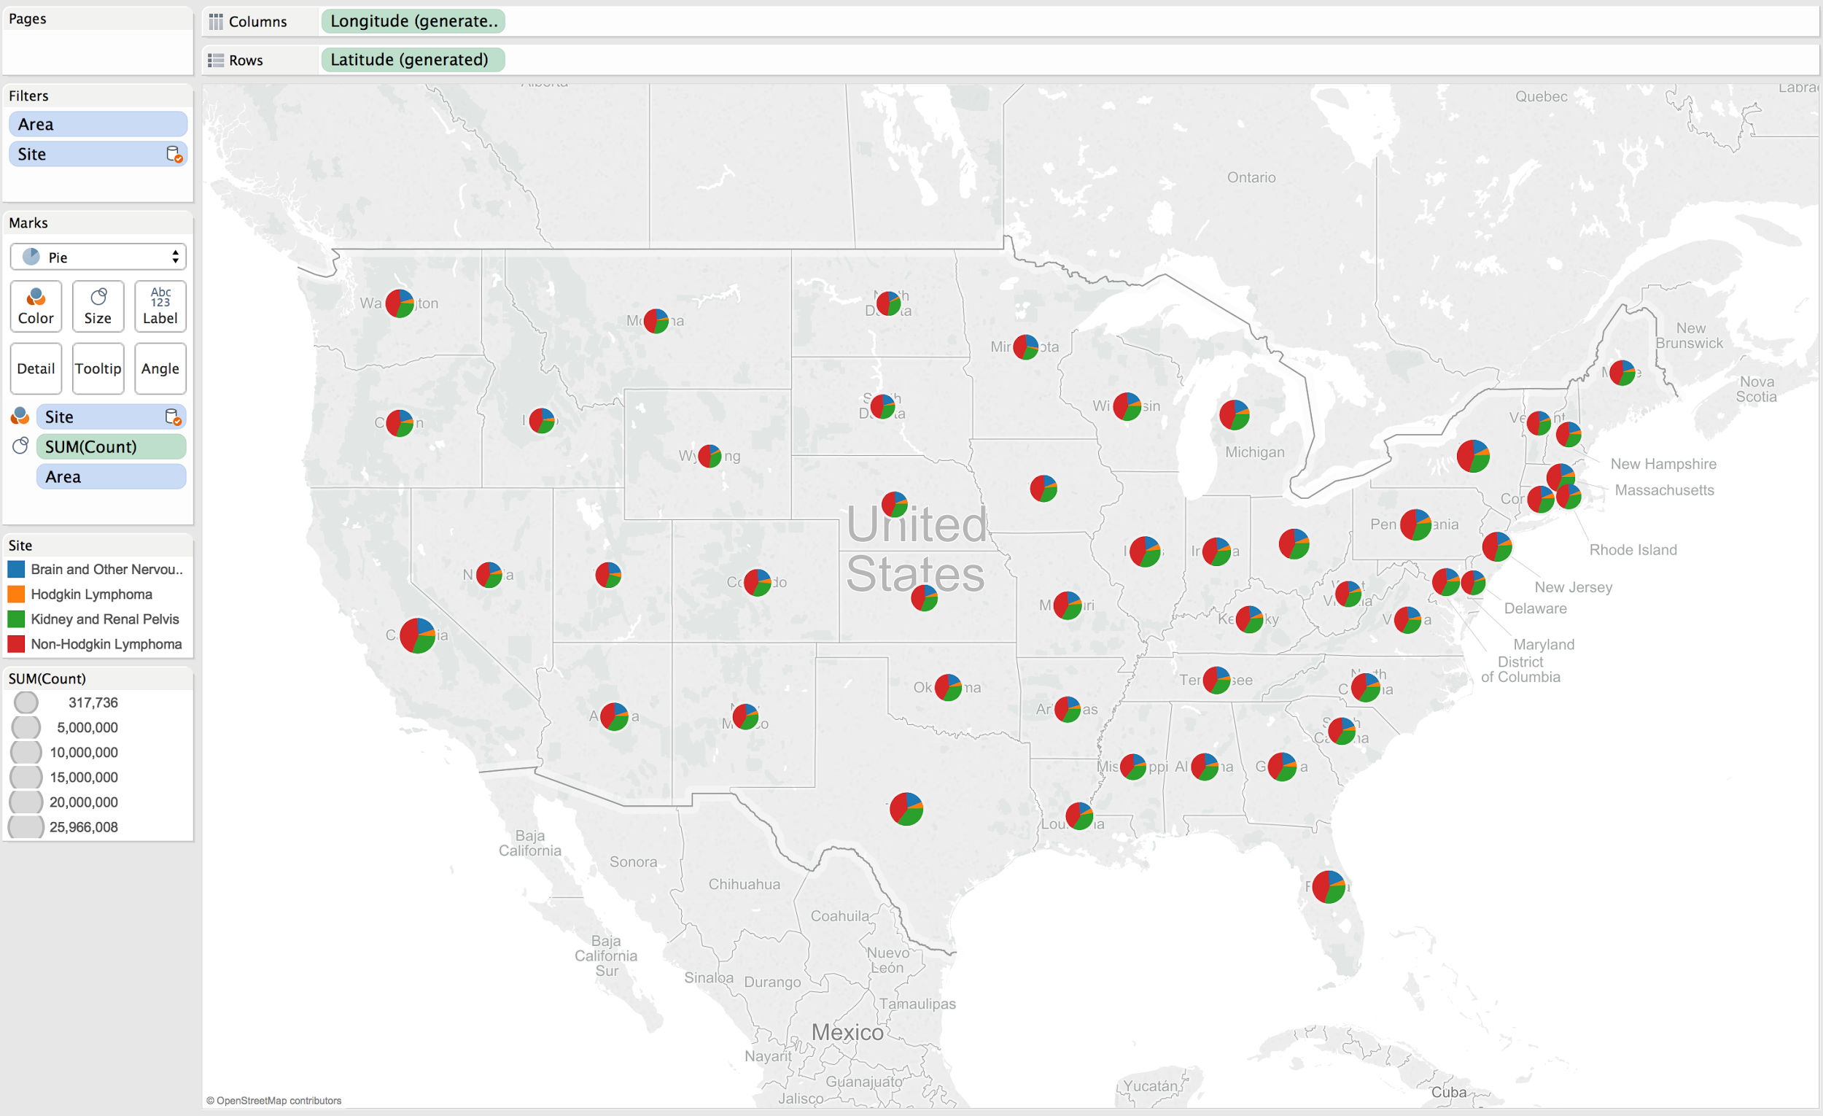
Non-Hodgkin Lymphomas are most common in each state.
Each state has similar proportions of cancer types

Slide 19
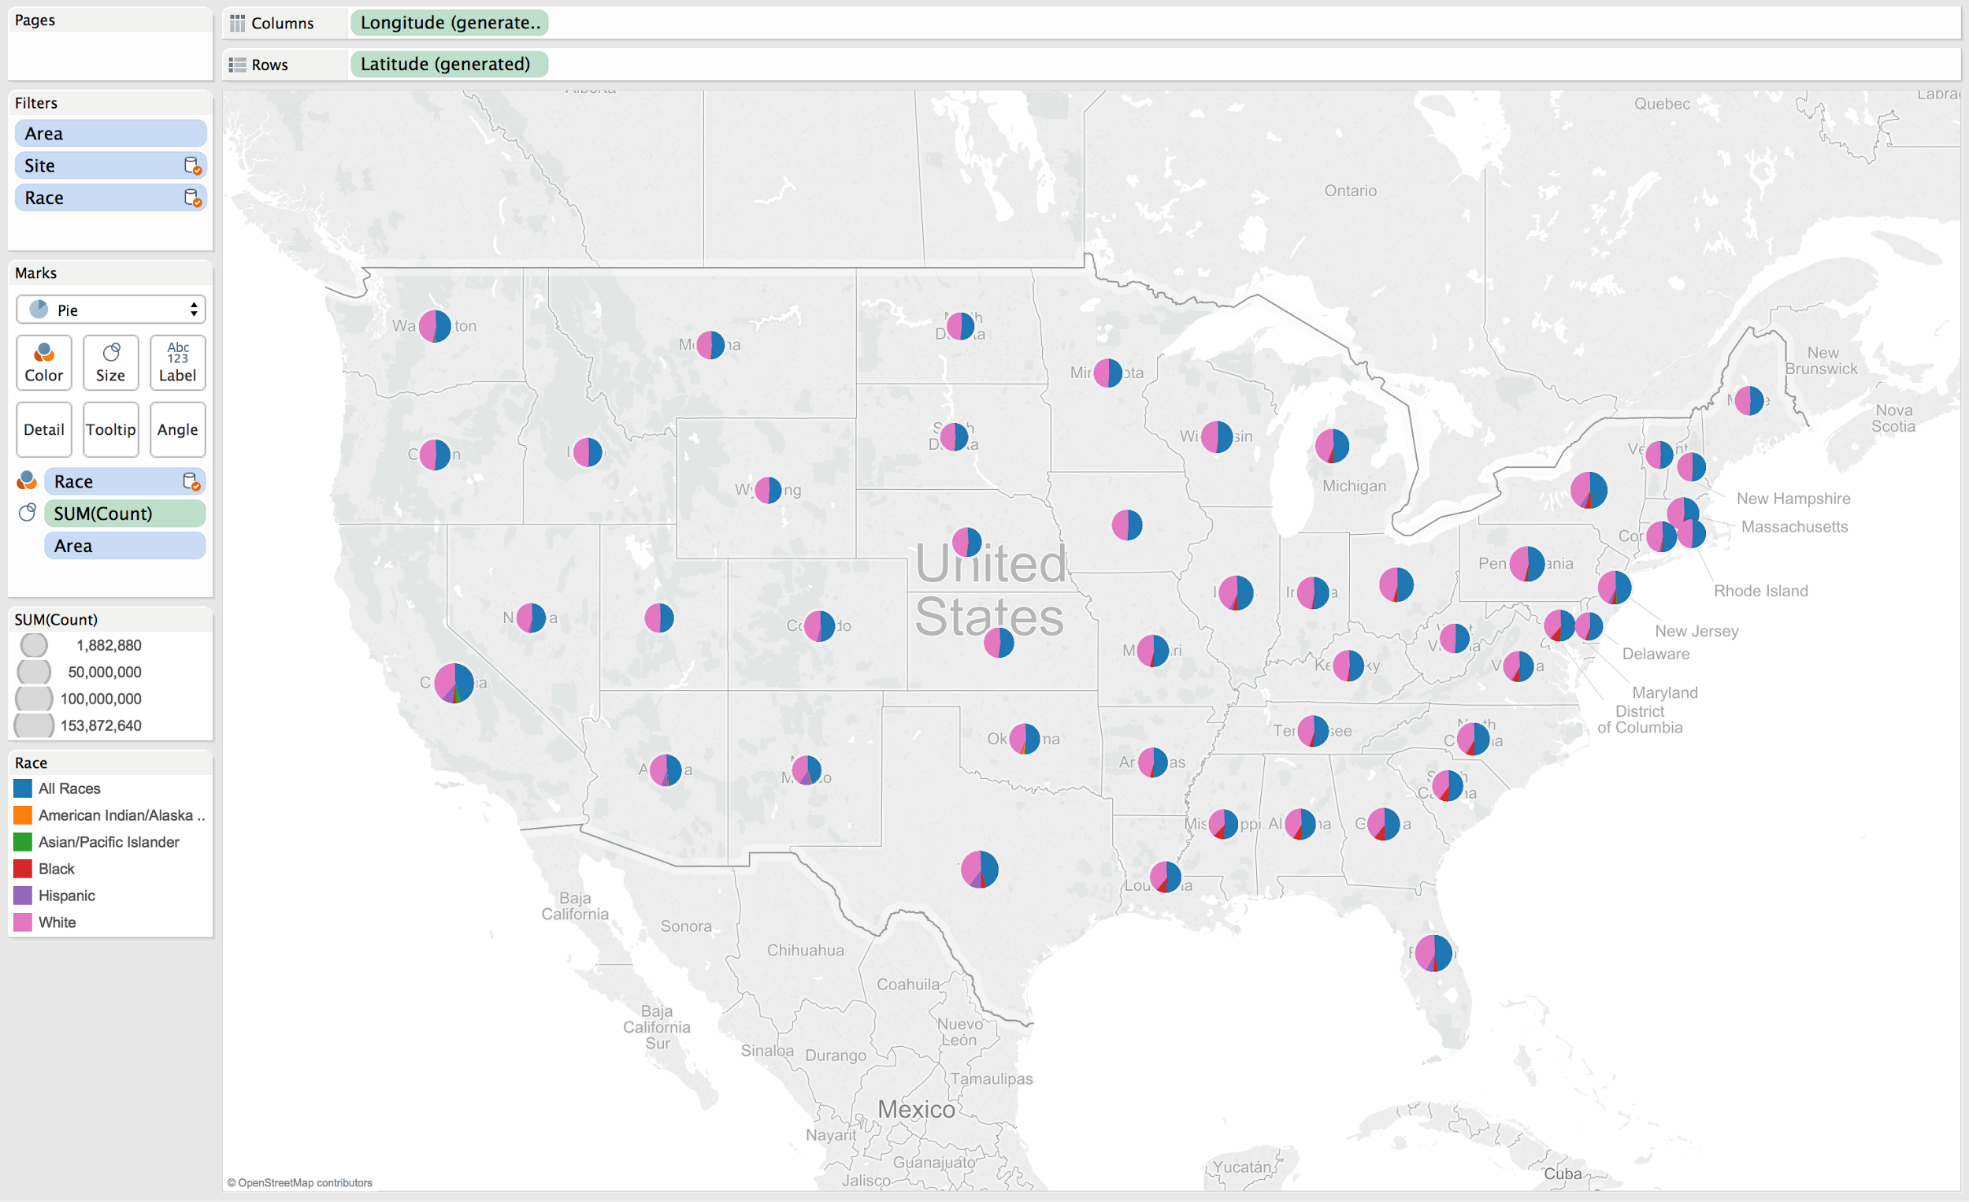
Focusing on Geography
White people form the majority in every state

Slide 20
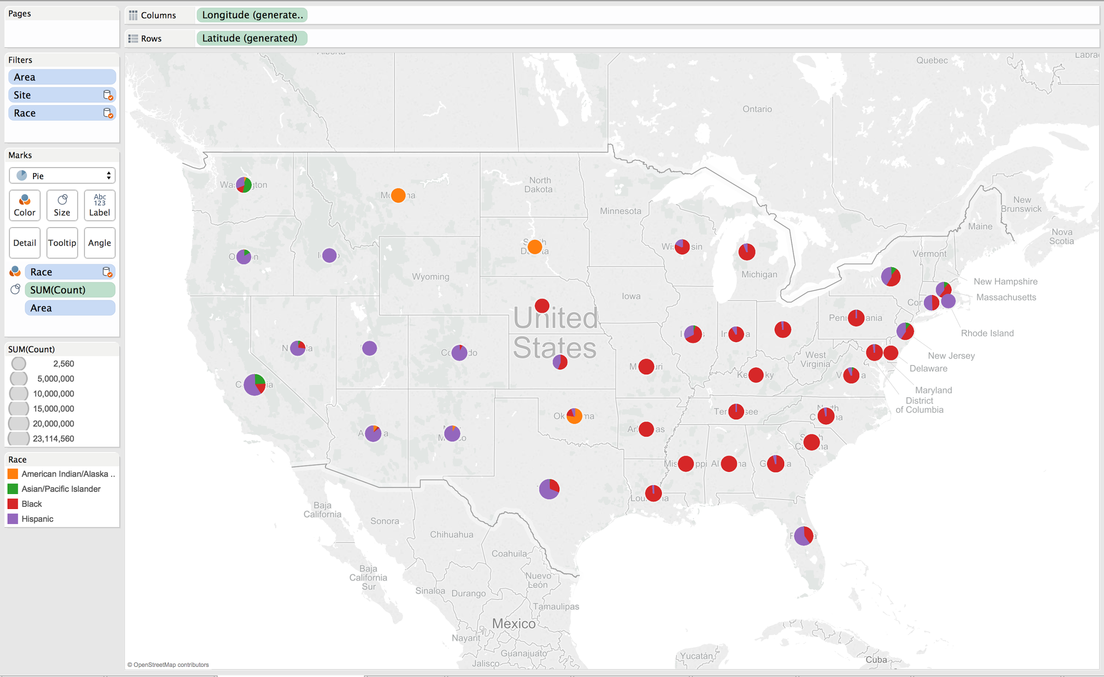
Follow the demographic ratios that prevalent in these regions
Minorities either do not exist or do not get cancer in the Central North

Slide 21
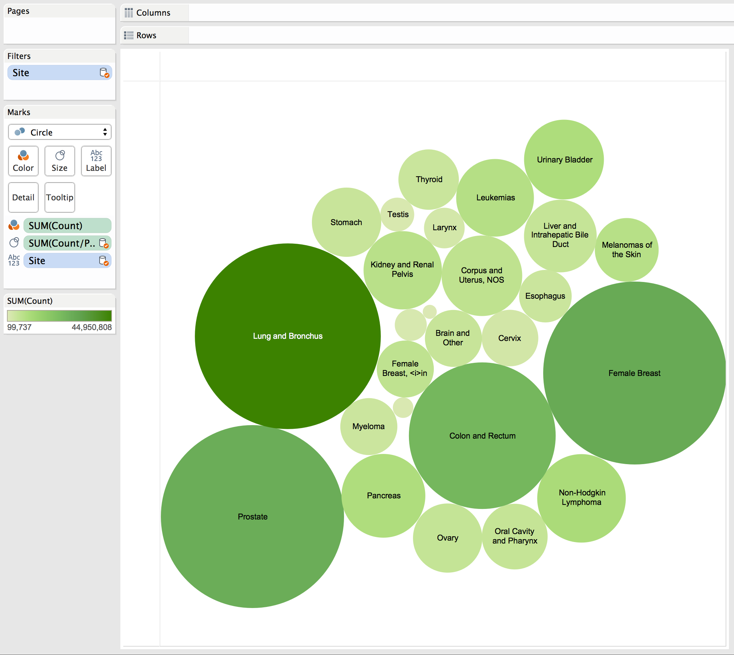
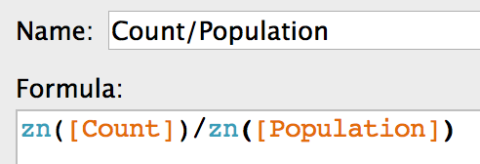
Count/Population calculation factors in state populations
Lung, prostate, and breast cancers in lead by percentage
Lung cancer in lead by count

Slide 22
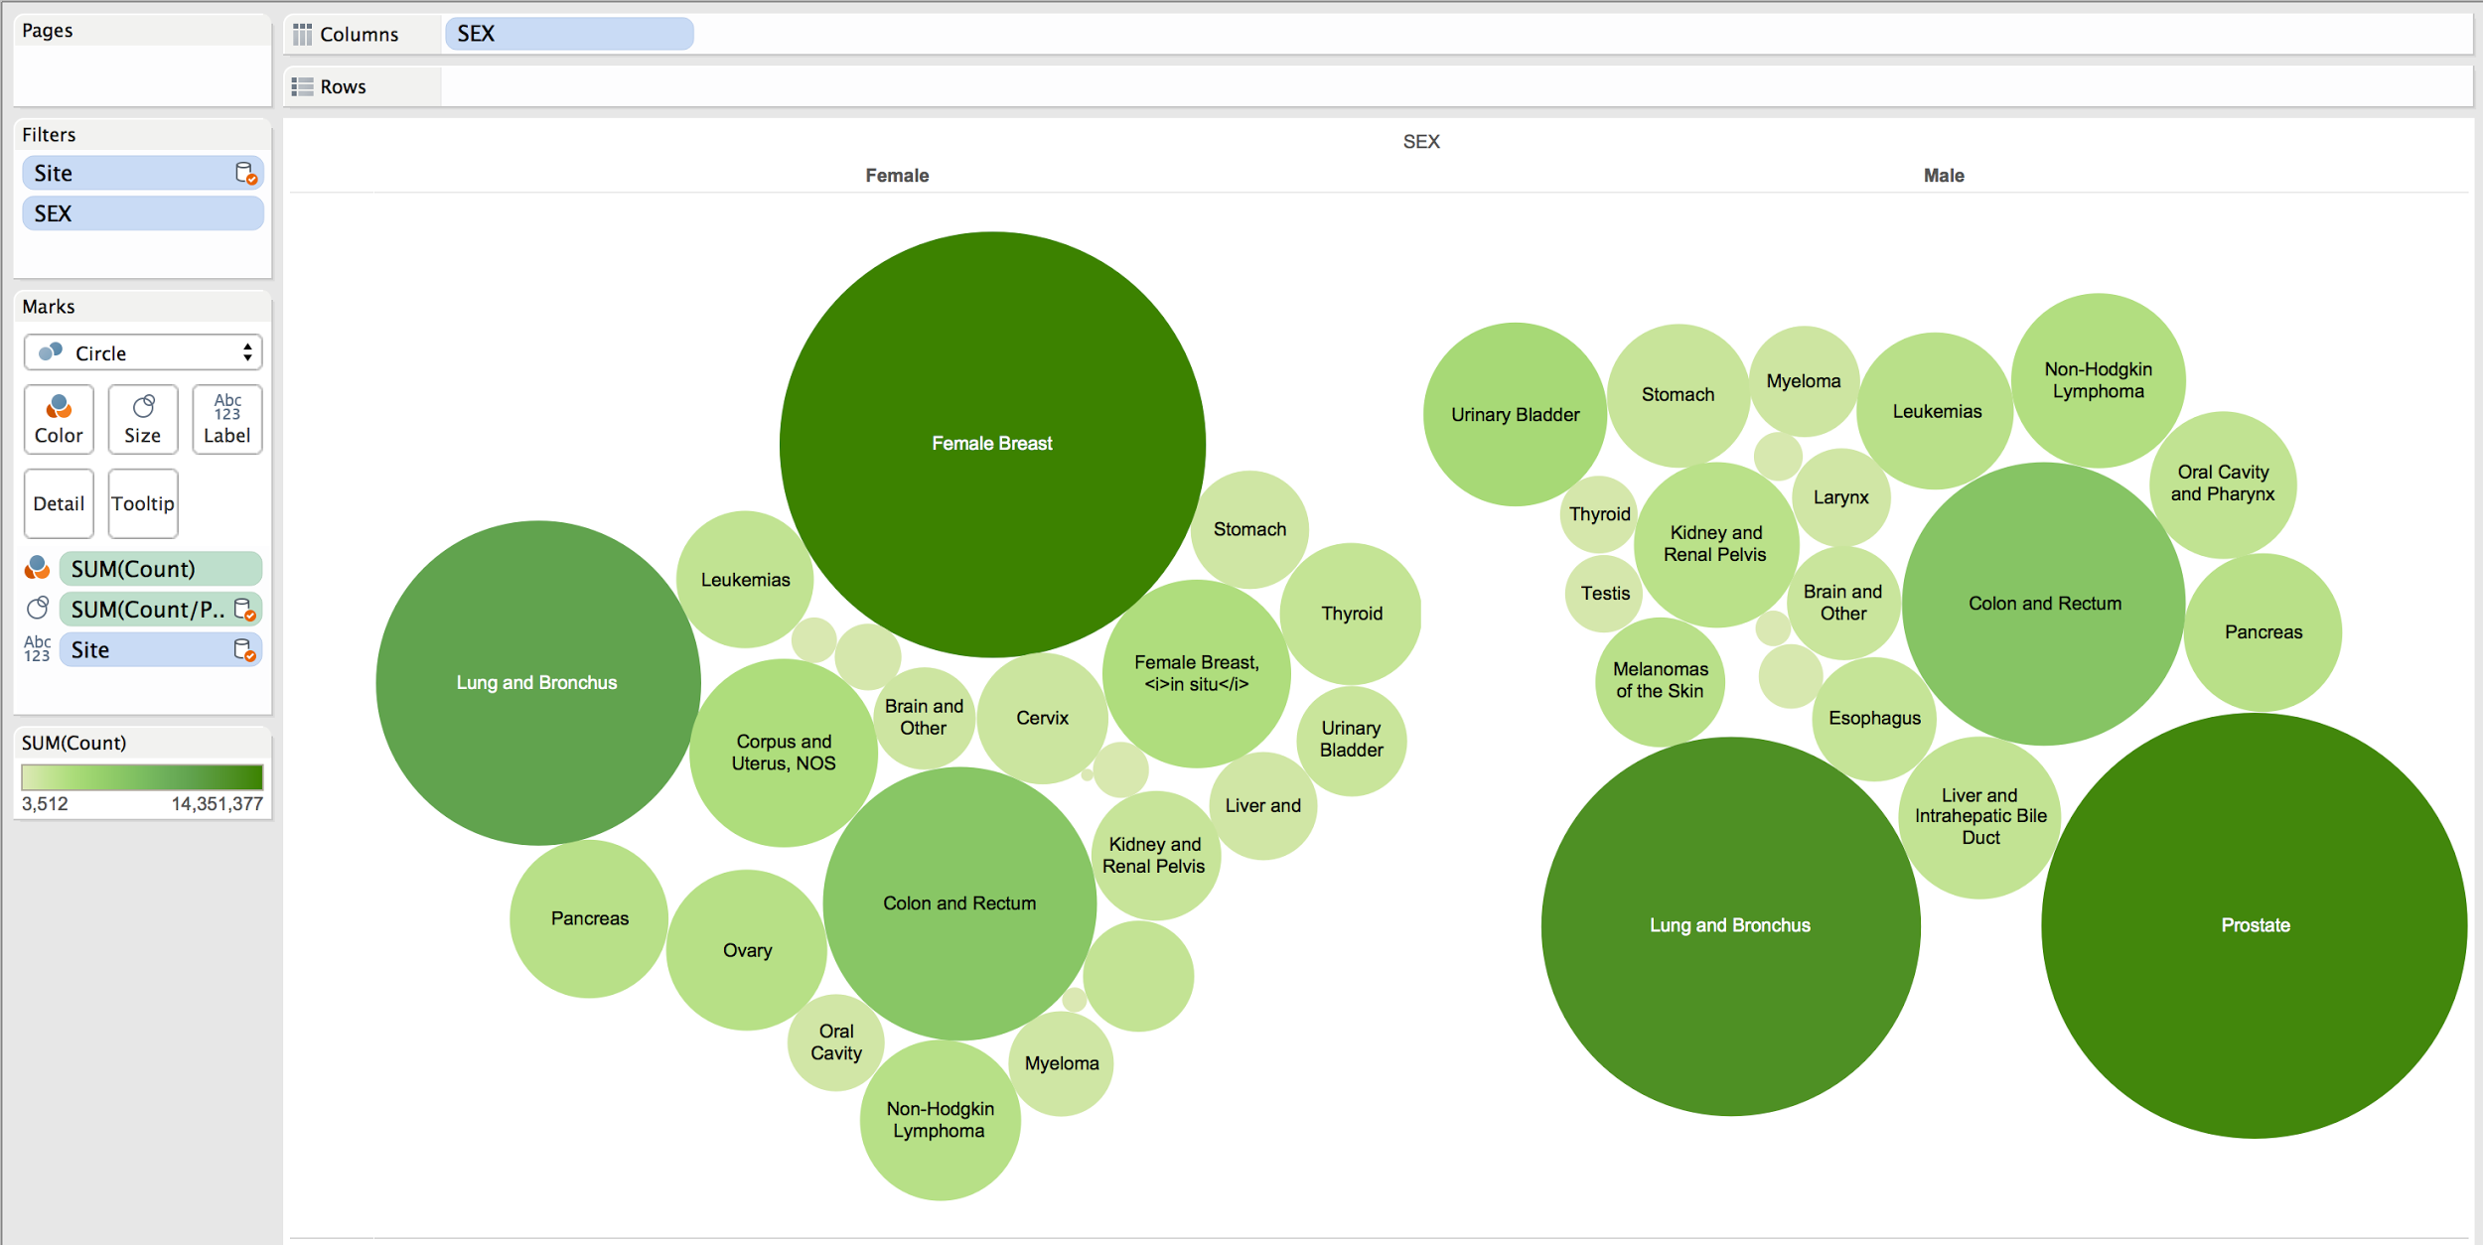
Female breast cancer for females
Prostate cancer for males
Lung cancer for both

Slide 23
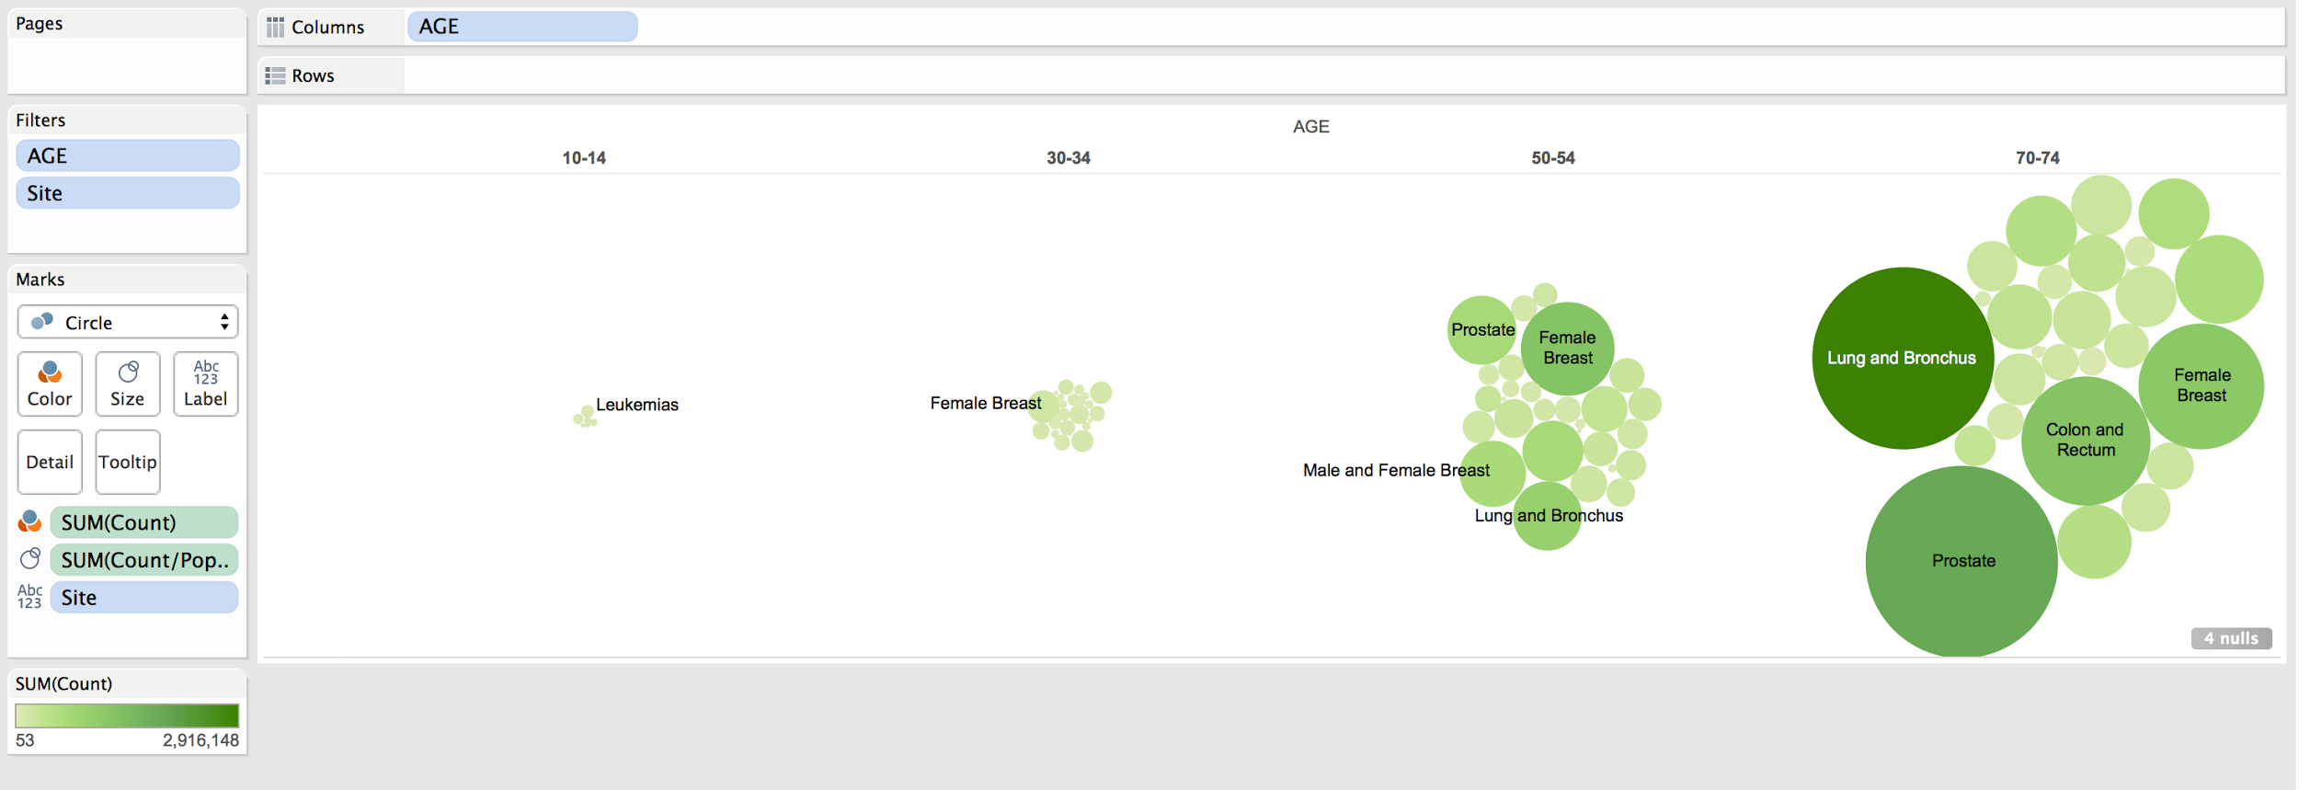
Cancer becomes a growing concern as one ages
Female Breast Cancer concern for women for majority of lives

Slide 24
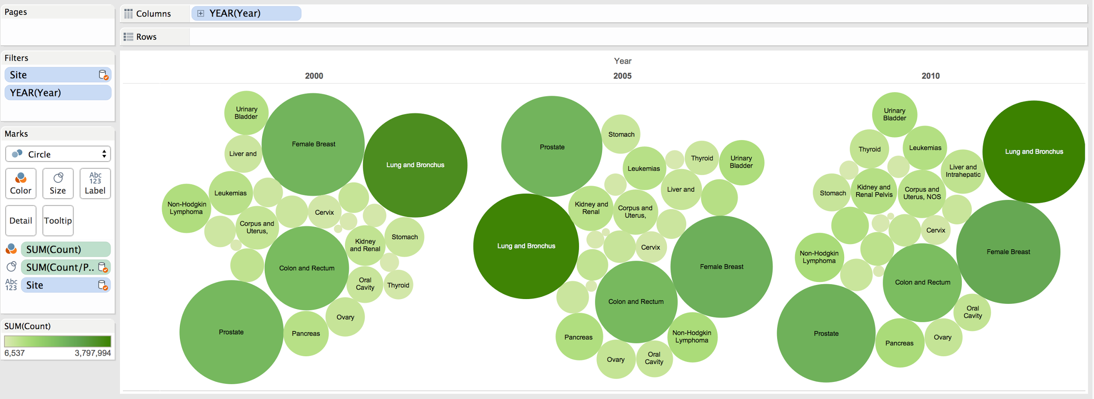
Proportion of cancers staying constant
Quantity of cancer incidents increasing
Cervical cancer decreasing (HPV awareness)

Slide 25
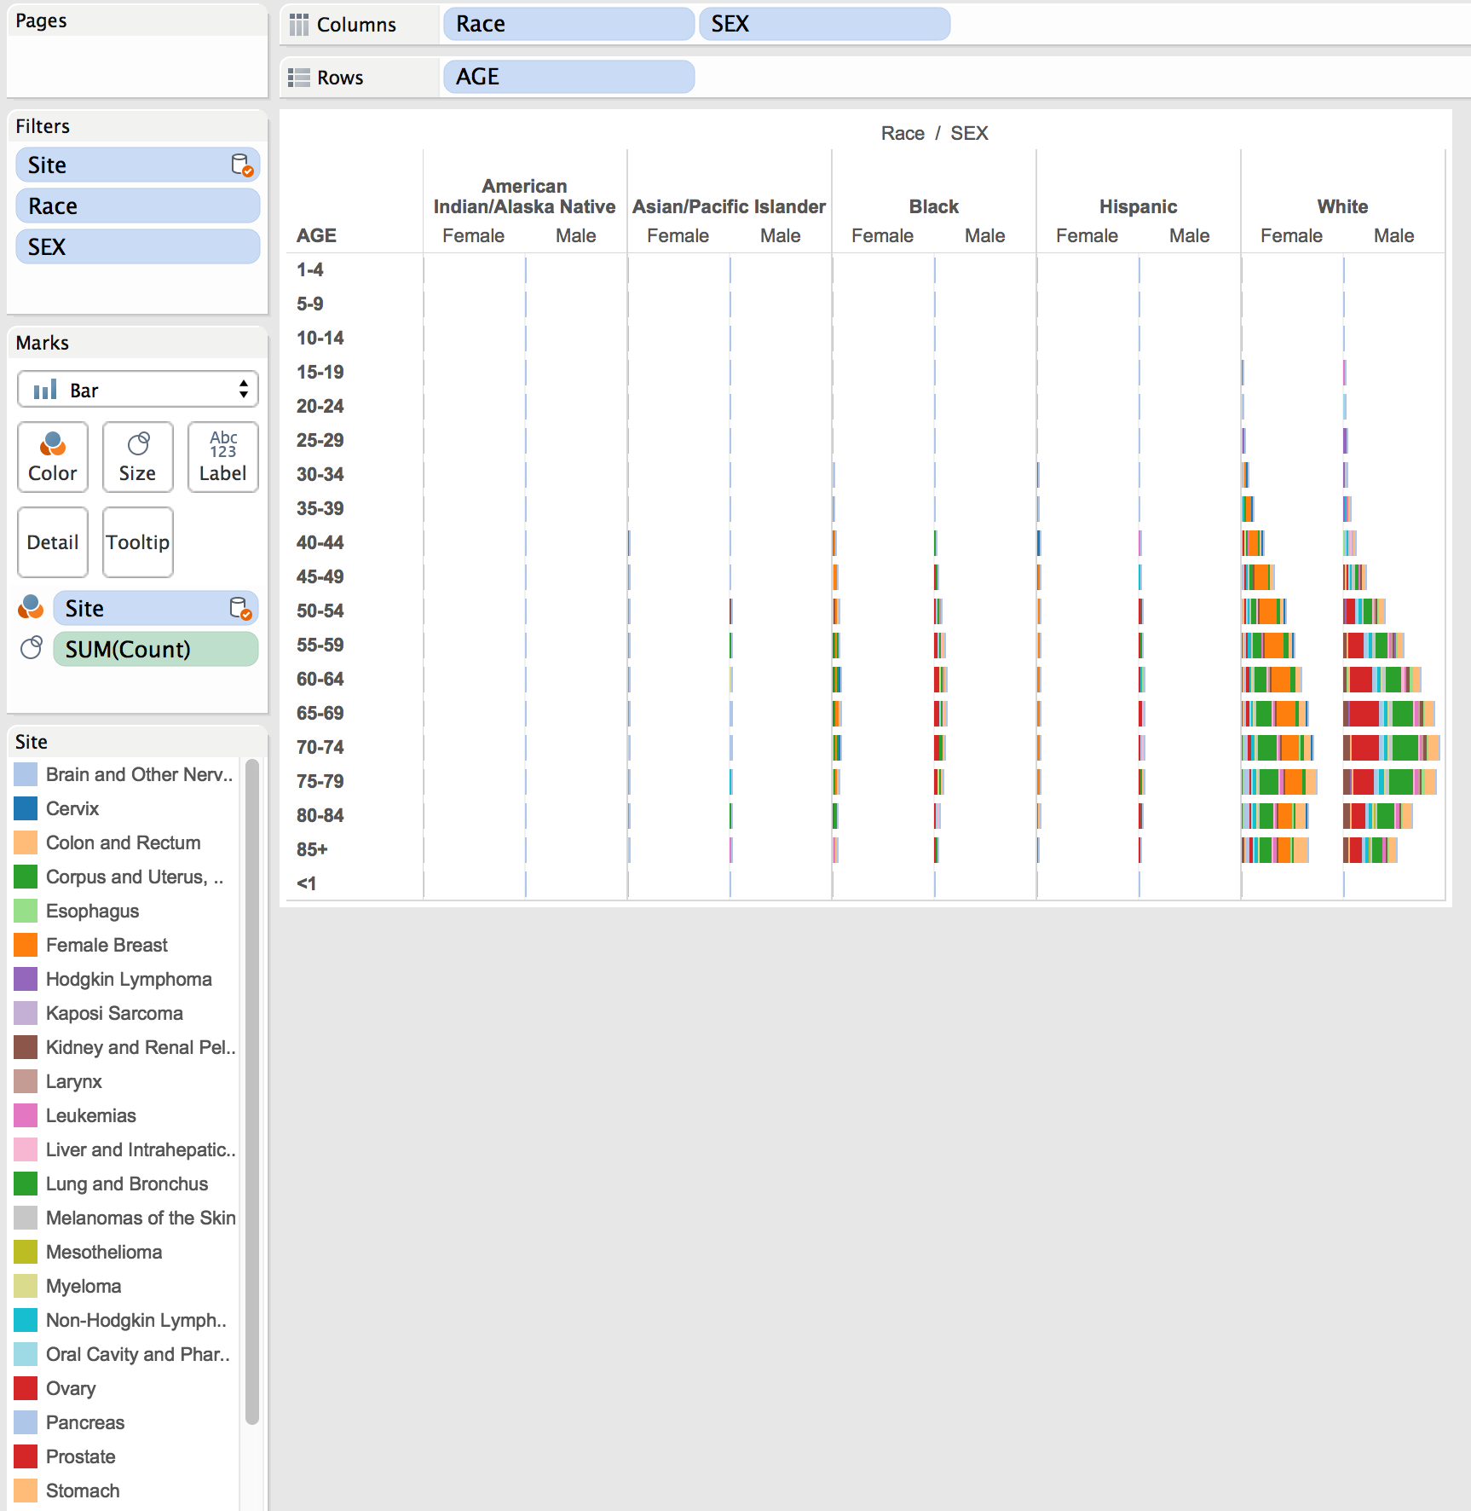
White people have the highest occurrence and most variety
Most populous?
Other factors?
Males out-diagnose females around ages 55-84

Slide 26
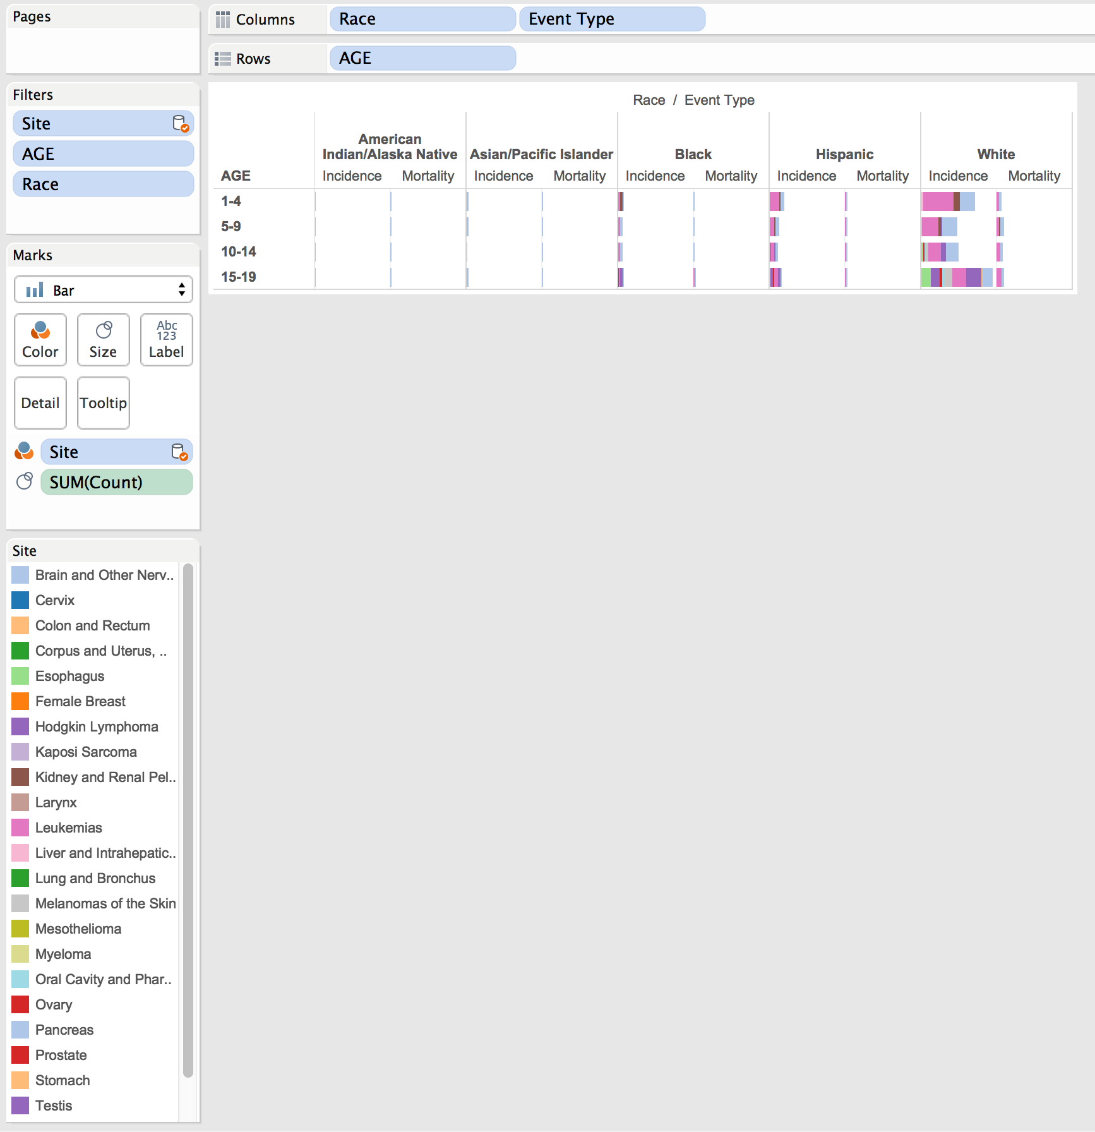
Most children with cancer will recover
Early childhood plagued by leukemias and brain cancers
Age 15 begins seeing variety of cancers (thyroid, testicular, melanomas)

Slide 27
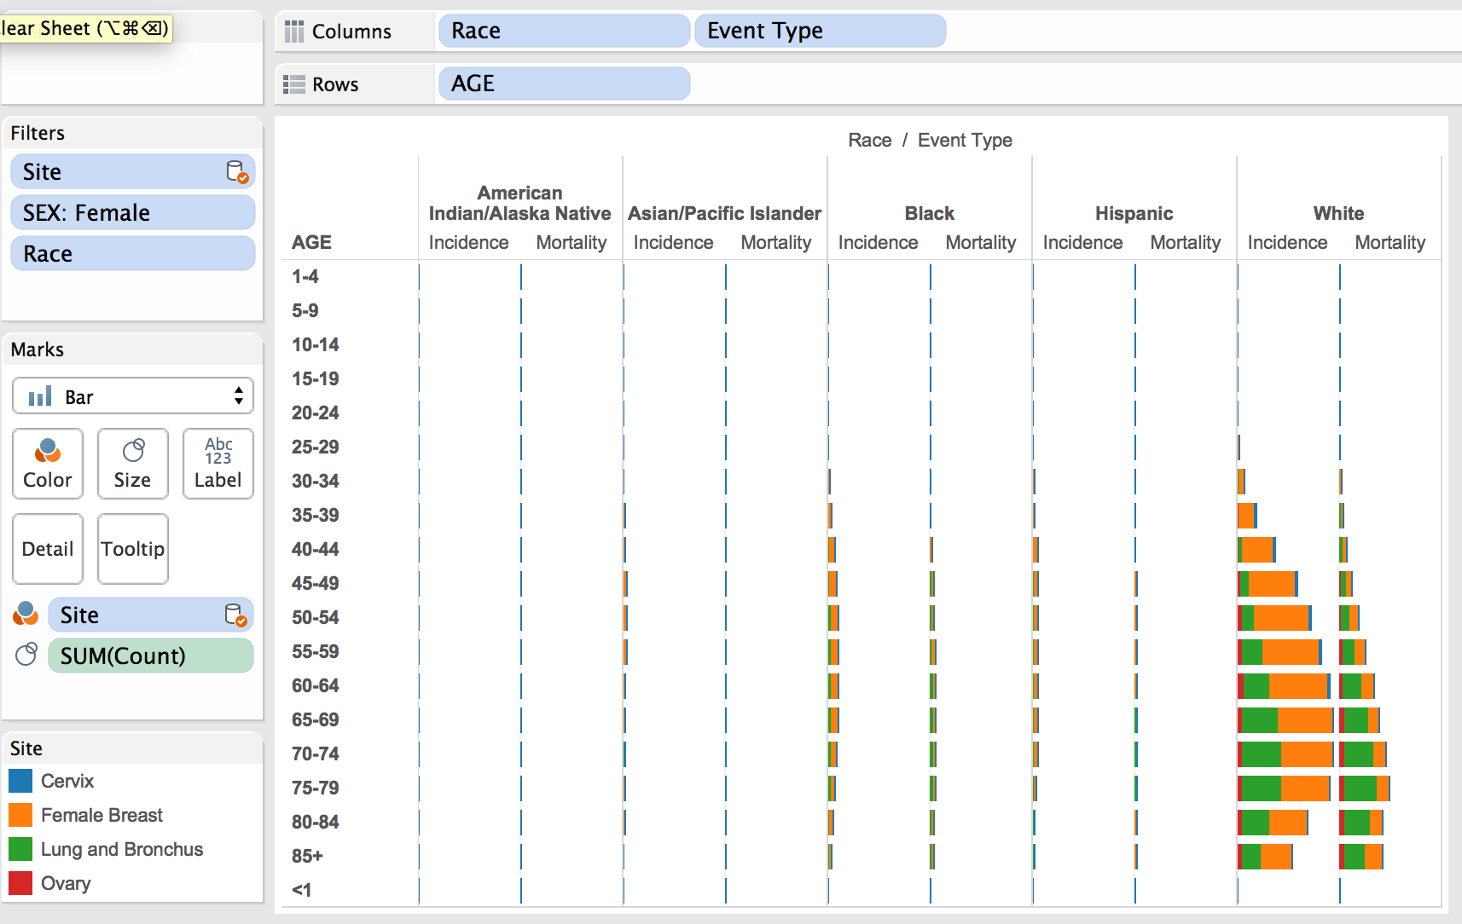
Females increasingly diagnosed at age 35
Most common is breast cancer
Most lethal is lung cancer

Slide 28
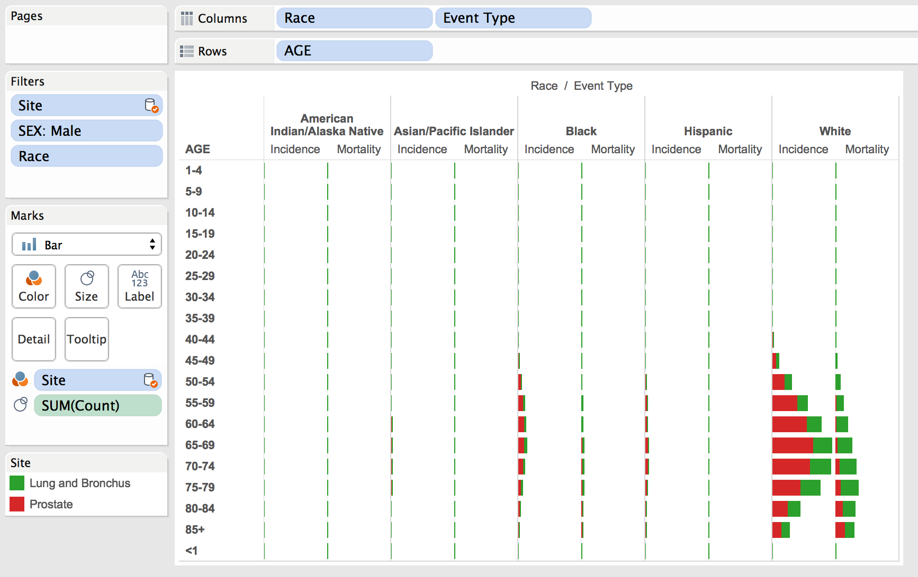
Males increasingly diagnosed at age 55
Most common is prostate cancer
Most lethal is lung cancer

Slide 29
Summary of Findings
Highest at risk groups:
Males 55+
Females 35+
White (variety of biasing factors possible)
Most common cancers:
Leukemia, brain (children)
Prostate, lung (adult male)
Breast, lung (adult female)

Slide 30
Summary of Findings
Mortality rates relatively low to total cases
Cancer becoming larger problem each year

